Slide 1
Recap of work so far
The Hausfather interview
What a model “is”
Earth.nullschool.net products

Slide 2
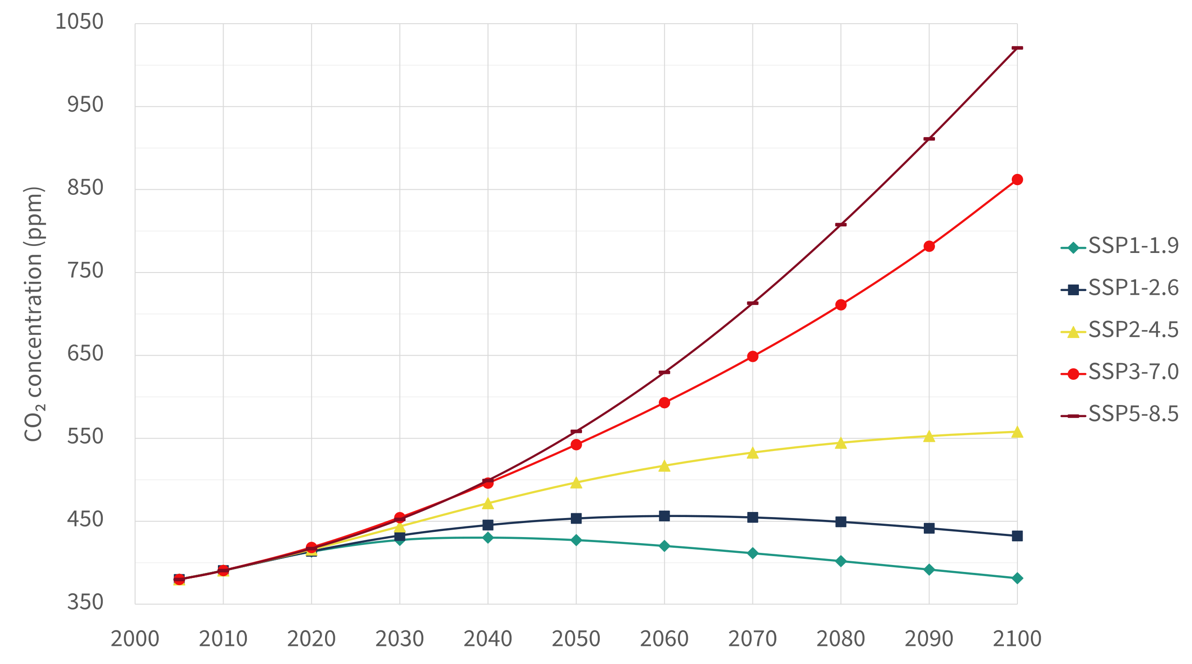
Acronyms:
RCP = Rep. Conc. Pathways (5th IPCC report, 2013)
SSP = New future scenarios (6th IPCC report, 2021)
“Trumpworld”
https://en.wikipedia.org/wiki/Shared_Socioeconomic_Pathways

Slide 3
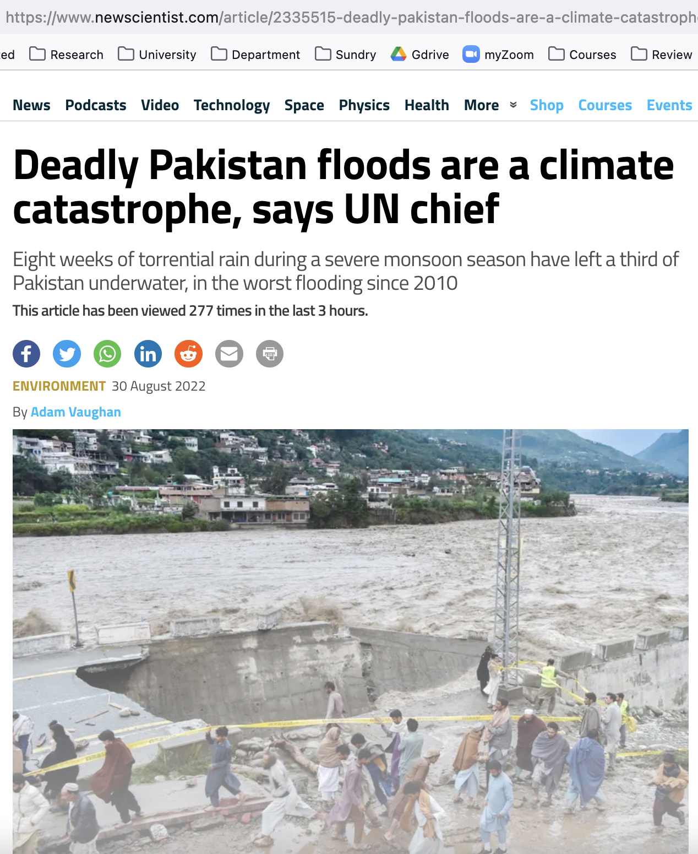
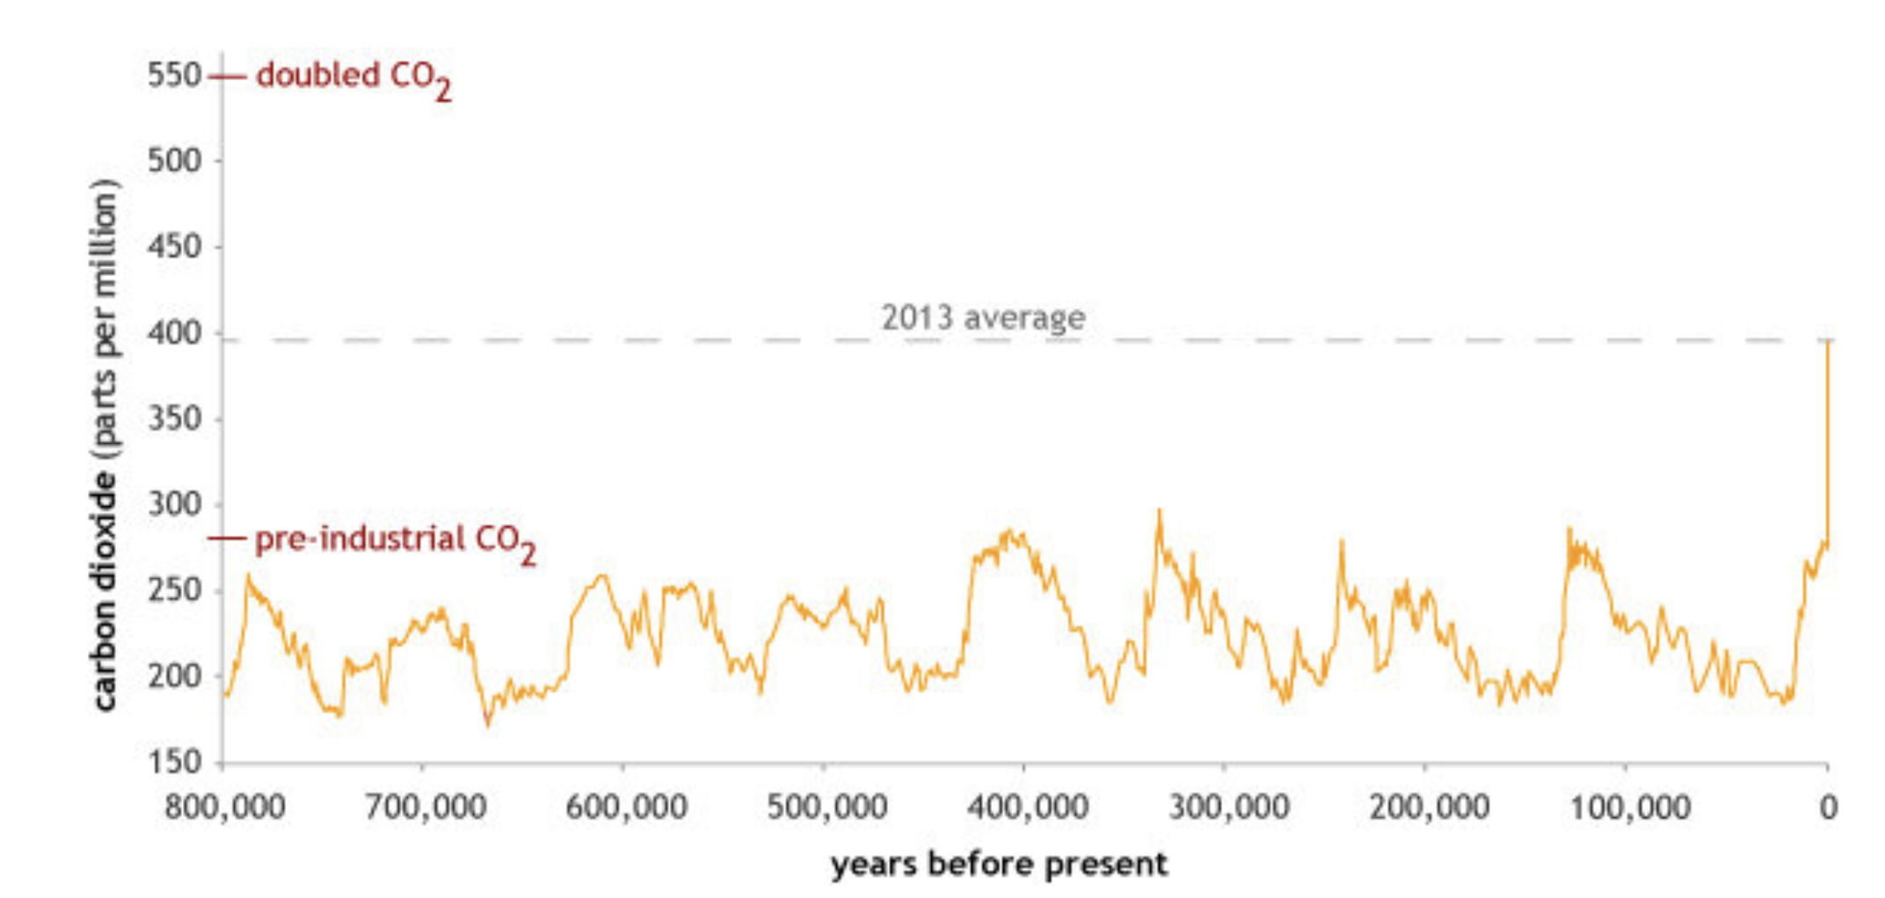
Other vocabulary:
Climate sensitivity – how many degrees warming for a doubling of CO2? (that’s doubling from pre-industrial)
https://www.climate.gov/news-features/climate-qa/how-much-will-earth-warm-if-carbon-dioxide-doubles-pre-industrial-levels

Slide 4
Recap: What a model “is” (paraphrasing Prof. Shell)
Set of mathematical equations, computer code, that simulates the climate in some way
Takes inputs, produces outputs
Often we want to integrate forward in time from some initial condition (we’ll use Euler’s method)
Experiment = one or more individual simulations designed to answer some question (like: What changes if we double the CO₂?)

Slide 5
Recap: Earth.nullschool.net products
Fires
Jet Stream
Have to move up in the atmosphere to see this
Surface air pollutant concentrations
This is CO, but there are also air-borne particulates, like sulfate (”SO4ex)
CO₂ concentrations
A key number is 418 ppm, the global average concentration in 2021

Slide 6
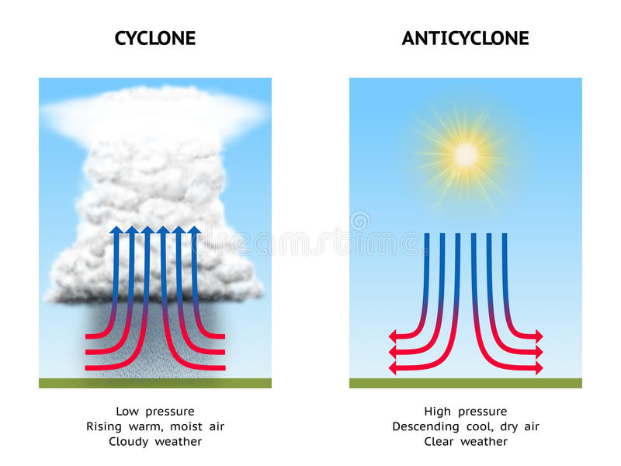
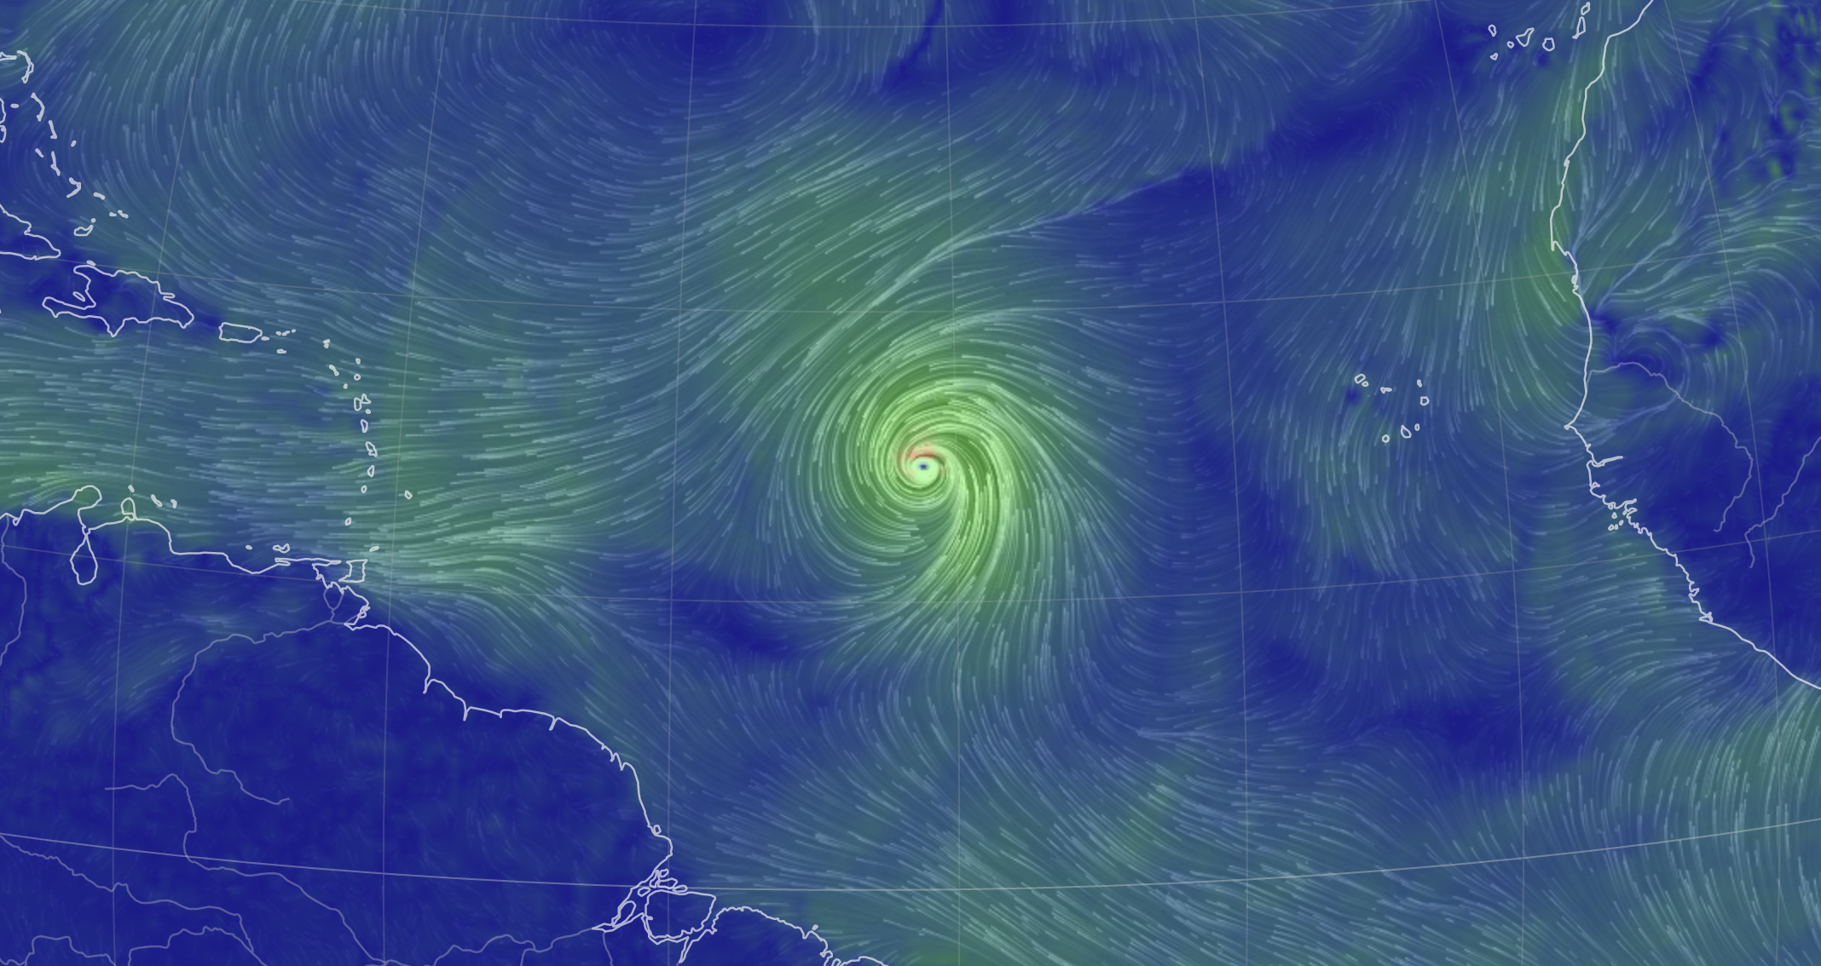
Cyclonic systems
Low-pressure system – stormy, cloudy, and rainy
Northern hemisphere, winds circling to the left
Southern hemisphere, winds circling to the right
https://thumbs.dreamstime.com/b/cyclone-anticyclone-diagram-illustrating-high-pressure-low-pressure-57971714.jpg

Slide 7
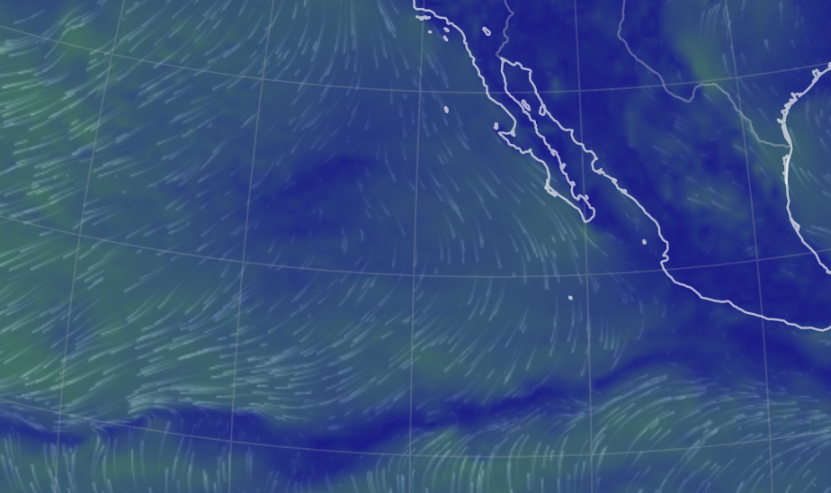
Anticyclonic systems
High-pressure system – Clear skies, dry
Northern hemisphere, winds circling to the right
Southern hemisphere, winds circling to the left
https://thumbs.dreamstime.com/b/cyclone-anticyclone-diagram-illustrating-high-pressure-low-pressure-57971714.jpg

Slide 8
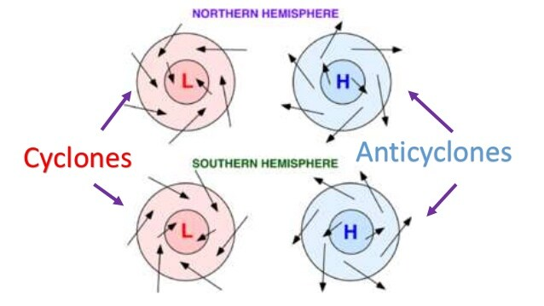
Summary of cyclonic & anticyclonic wind directions
https://revision.co.zw/cyclones/

Slide 9
What we’re up to today
low-pressure (“cyclonic”) vs high-pressure (“anti-cyclonic”) systems
You can tell which is which by the way the winds circulate, but the rule depends on whether you’re in the northern hemisphere or the southern
You can also tell by the pressure (“MSLP”) in the center.
You can also check out CO₂, CO, fires

